Slide 1
CitiSpirit
Presented to you by City Hustlers
Eaint Thiri Khit
Foo Chun Keat Alan
Heng Qhew Zi
Teo Keng Swee

Slide 2
01 PROBLEM
Problems that revolve around the banking and finance sector in the 21st century

Slide 3
KEY PROBLEMS
CYBERATTACKS AND DATA BREACHES
LACK OF
FINANCIAL LITERACY
In Dec 2021, around 790 OCBC customers were targeted in a phishing scam resulting in a loss of at least $13.7 million.
55.2% of adults in Singapore say they are financially illiterate and as such are unaware of their expenses every month.
63% of financial institutions experienced an increase in data breaches in 2022.
50.3% of the respondents come from an age group of 35 to 47 years old.

Slide 4
02 Solutions
Features provided by CitiSpirit

Slide 5



OUR KEY FEATURES
Blockchain Identity Management
Gamification Elements
Wealth Portfolio
Management
Educational Channel
Utilizing Web3 OpenLogin authentication to decentralise the users identities so as to prevent potential data leakages.
Engage customers to embark on learning financial skills through the provision of mini quiz challenges and redemption of rewards.
A dashboard platform to give an overview of the users’ target portfolio status and their investment details.
A platform which educates users to be more financially literate through the use of online resources.

Slide 6
03 TECHNOLOGY
Our choice of technology in creating CitiSpirit

Slide 7




TECH STACK
MongoDB
Express JS
React JS
Node JS
A fast and scalable database management system which will store the users’ credentials as well as their investment portfolio data in key-value pairs.
An efficient and scalable server-side application framework which facilitates the handling of HTTP requests and responses.
A simple to use frontend framework which promotes code reusability and dynamically renders the data that user has changed.
A highly efficient, open source Javascript runtime environment which can handle a large amount of simultaneous connections asynchronously.

Slide 8










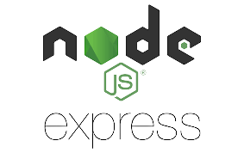







Solution Architecture
Hybrid Decentralized Microservice Architecture, Tools & Technologies for Citi-SPIRIT
Web Application Devices
Blockchain Technology
Ethereum Blockchain
Web3Auth Digital Identity
Moralis Web3 API
Flask IoT App Microservice Cloud Run
Authentication
Express
Backend Cloud Run
Datastore Cloud Bigtable
React Frontend App Engine
Cloud Load Balancing
Analytics Backend BigQuery
Autoscaling
MongoDB
Atlas noSQL
Static Files Cloud Storage

Slide 9
04 BUSINESS USE CASE
How can CitiSpirit be used to enhance the lives of the individuals within the community

Slide 10




STEPS TO TAKE
STEP 1
STEP 3
STEP 2
STEP 4
User signs up and log into CitiSpirit application
User clicks on Planning tab to select the preferred financial services to plan for his or her target portfolio
User is directed to Landing Page
User clicks on Dashboard tab to see the changes for their target portfolio

Slide 11



STEPS TO TAKE
STEP 5
STEP 7
STEP 6
Users click on Quiz tab to play the mini financial trivia quizzes and earn points
User clicks on Tutorials tab to enrich himself on financial know-hows
Users go to Rewards page to redeem prizes based on their earned points

Slide 12
05 TARGET AUDIENCE
Our target audience demographics, their needs and wants

Slide 13
Meet Jack
BACKGROUND
DEMOGRAPHICS
Gender:
Age:
Marital Status:
Occupation:
MOTIVATION
Gross Monthly Income:
Jack has been living a comfortable life with quite a sufficient salary to support his own livelihood. However, just recently, his daughter has been accepted into a prestigious university and soon Jack feels that he needs to find alternate sources of income to support his daughter’s education as much as he can.
Male
45 yrs old
Married
Engineer
S$5800
As Jack has seen too many online scam cases, he wishes to look for a safe and secure platform that allows him to invest at ease.
Jack also wishes to look for a platform to learn more about investments since he has minimal knowledge about them.

Slide 14

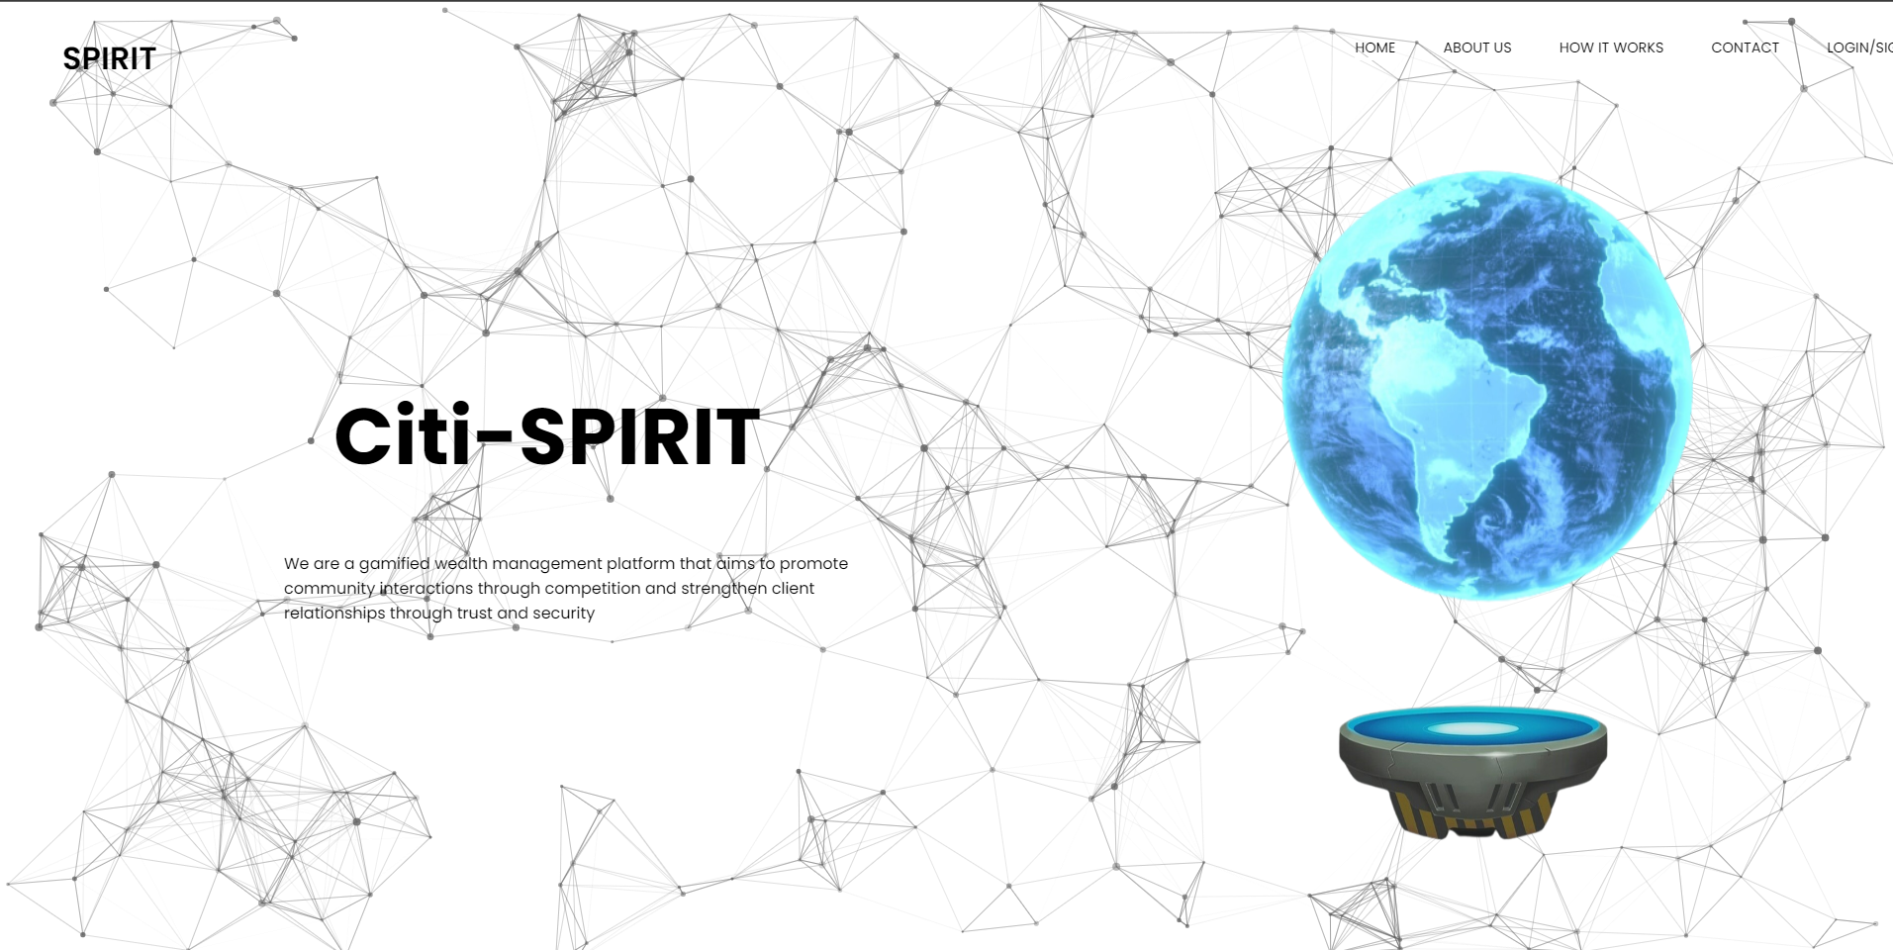
PRODUCT DEMO

Slide 15
06 ROADMAP
What CitiSpirit intends to implement in the long run

Slide 16


PRODUCT ROADMAP
Jan 2023
Apr 2023
Sept 2023
Dec 2023
Avatar Customization
Community Forums
Community Hedge Funds
Stock Price Prediction & Recommendation
Users will be able to create and customize their own avatars so as to get engrossed into getting into contact with the virtual financial universe of CitiSpirit.
According to users’ preferences, they will be able to join interest groups where they will exchange stock trading ideas and strategies.
Based on the consensus decision making model, users will form groups to strategize on purchasing certain stock price
Users will be provided with timely stock prediction data and recommendations through the use of Artificial Intelligence and Machine Learning.

Slide 17
THANK YOU
We hope that CitiSpirit could be a huge asset to each and every individual within the Citi community.

